Slide 1


Mark My Vords presents:
Correct It!
Matthias Carroll, McKenna Galle, and Vina Le
CS172 Spring 2016

Slide 2

Our Project
Alternative to Microsoft Excel
Makes it easier for an instructor to compare answers
Automatically assess student’s answers
Collectively counts students’ correct answers
Notes:
Vina

Slide 3

The Program
Wrote an object-oriented console app
Includes two classes:
‘Tests’ class – inputs correct answers
‘Student’ class – takes student answers and compare with answer key from ‘Tests’ class.
Takes the student ID to display grades in text file
Includes pointers and file output
Notes:
Matty

Slide 4

Challenges
Inheritance between classes
Automatic counting correct answers
Storing answer keys for later use
File-output from console to text file
Refining the ‘class’ design – condense
Over-thinking the functions
Notes:
Vina

Slide 5

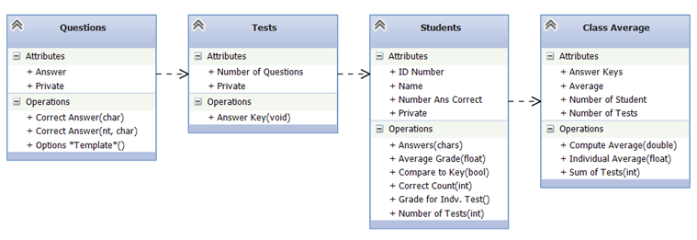
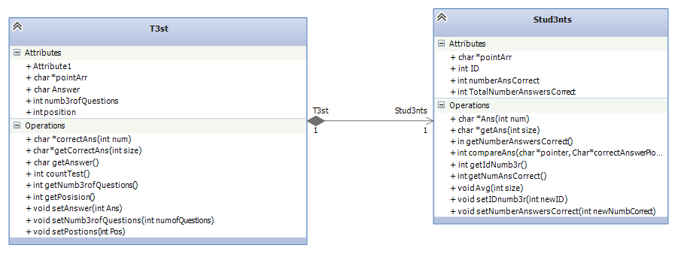
Our Design
:Our original UML
Revised:
Notes:
McKenna

Slide 6

Demonstration
Stay tuned:
Notes:
eminem

Slide 7

Improvements
If we were to do this again:
If we had more time:
Students will have opportunity to enter own answers.
‘int’ answers, not only ‘chars’.
App will create its own answer key.
Apply random answers
Add a class average
Storing all students’ data in array
Output each test into a file
Make it more pretty and organized.
Notes:
Vina

